Slide 1
Putting genetic variation on the map
tess3r
spaceMix
EEMS
Un-PC

Slide 2
Idotea baltica
admixturePlotting_v5.R

Slide 3
tess3r: plotting ADMIXTURE results on a map
tess3r

Slide 4
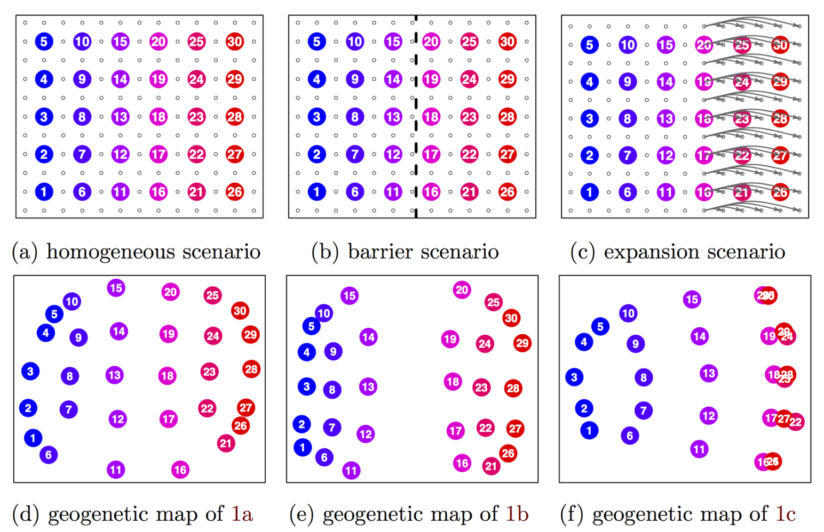
SpaceMix: detects of one-time long-distance migration events
Notes:
produces a map of the geo- graphic positions of the populations, but with distances distorted to reflect historical rates of gene flow. In the underlying model, allele frequency covariance is a decreasing function of geogenetic distance, and nonlocal gene flow such as admixture can be identified as anoma- lously strong covariance over long distances. This admixture is explicitly co-estimated and depicted as arrows, from the source of admixture to the recipient, on the geogenetic map.

Slide 5
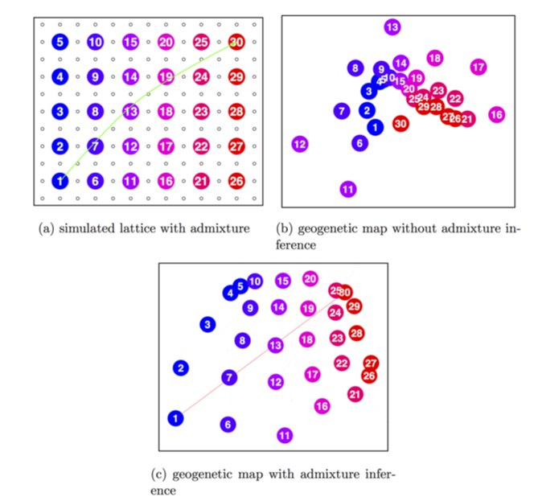
SpaceMix: detects of one-time long-distance migration events
Notes:
produces a map of the geo- graphic positions of the populations, but with distances distorted to reflect historical rates of gene flow. In the underlying model, allele frequency covariance is a decreasing function of geogenetic distance, and nonlocal gene flow such as admixture can be identified as anoma- lously strong covariance over long distances. This admixture is explicitly co-estimated and depicted as arrows, from the source of admixture to the recipient, on the geogenetic map.

Slide 6
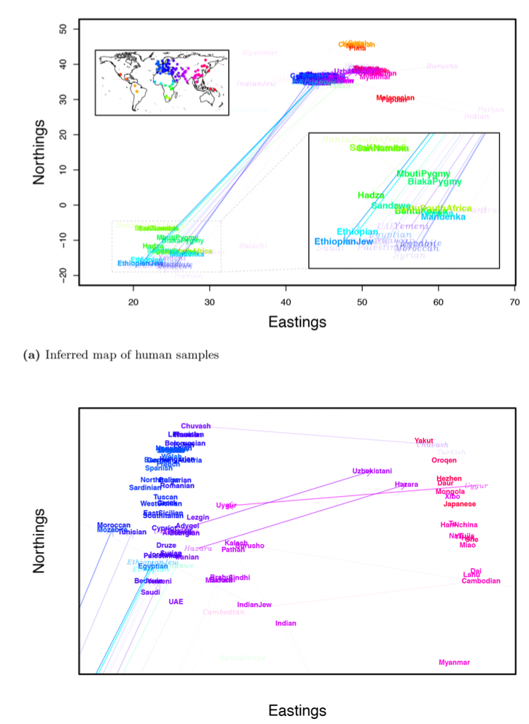
SpaceMix can get rather confusing with real data

Slide 7
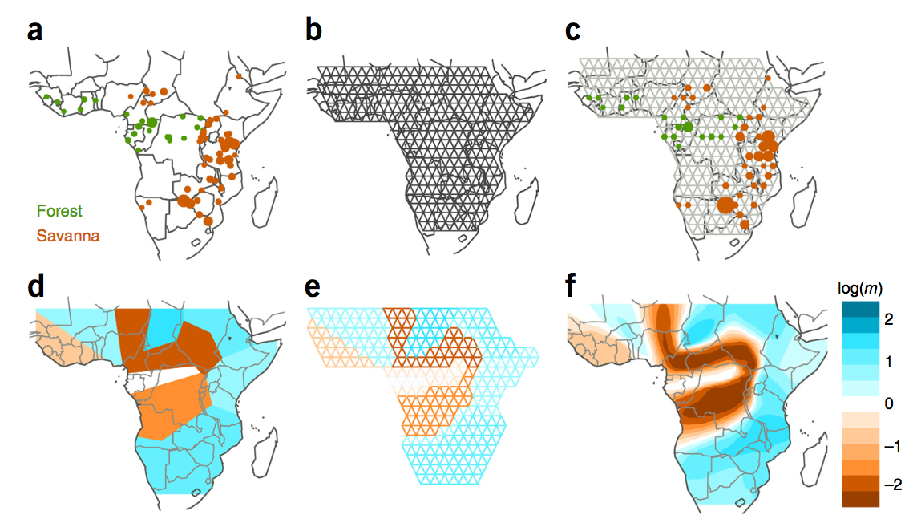
EEMS: quantifies barriers to migration between neighboring points in space
Looks for places on map where the rate of divergence accumulation with distance either speeds up or slows down

Slide 8
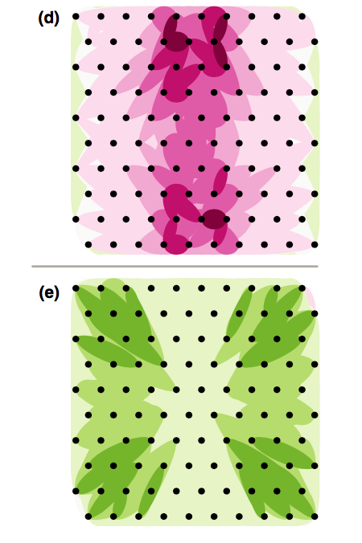
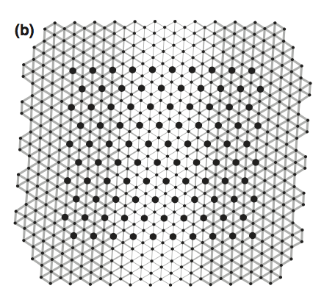
Un-PC: nice simple idea – let’s just plot higher-than-expected (given distance) or lower-than-expected pairwise divergences between populations as colored ellipses
Simulated migration rates
Lower migration
Higher migration

Slide 9
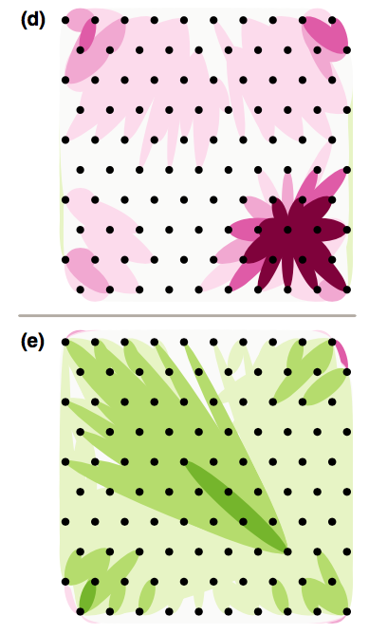
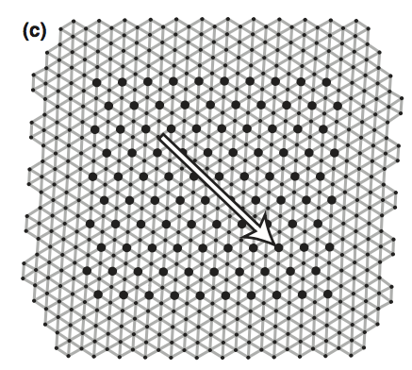
Lower migration
Higher migration

Slide 10
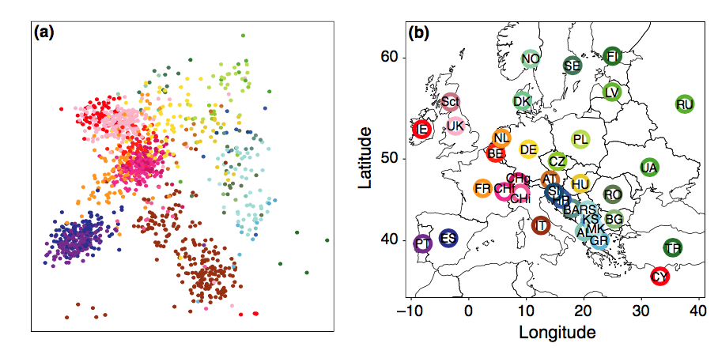
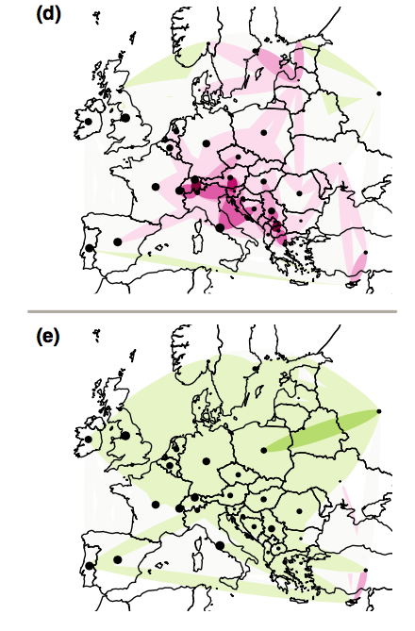
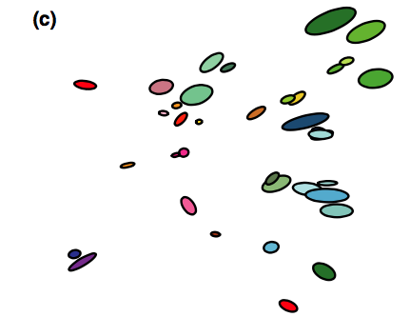
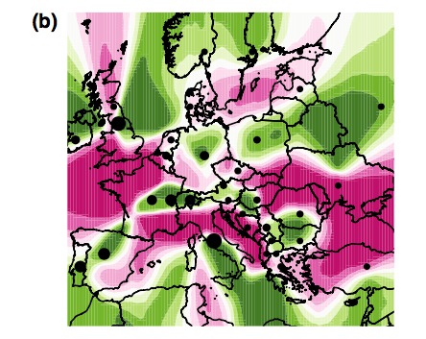
Un-PC
Lower migration
Higher migration
spacemix
EEMS

